Slide 1
Procedural Languages
Procedural languages are based upon machine architectures.
They are “High level” versions of machine and assembly languages
Program design is essentially top-down with step-wise refinement.
Design tools illustrate the approach:
  1. Functional decompositions
  2. Data Flow Diagrams – comprised of:
    functions
    dataflows
    data stores
  3. Structure Charts – show calling graphs for functions with parameters and return values indicated.

Slide 2
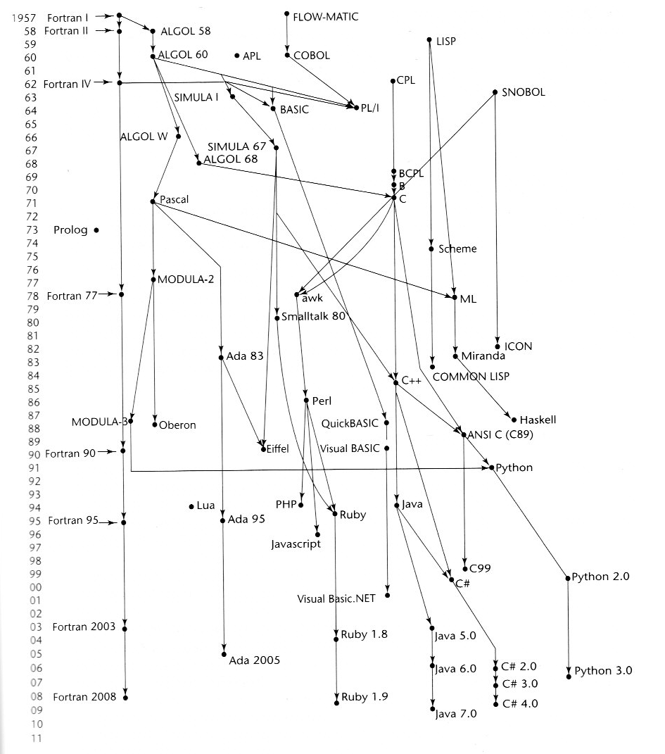

Slide 3
Procedural Languages
COBOL:
  ANSI standard: 1968 with many modifications
  2002 standard includes OO and other modern language features
  Y2K investment has meant new life for many COBOL programs
Fortran
  Recursion as of Fortran 90
  mainstay for supercomputing:
    weather and climate modeling
    computational fluid dynamics
    computational chemistry
    computational economics
Basic
  Teaching language
  Lives in descendants
Algol 60 and descendants
  Supported Structured Programming
  More popular in Europe
Ada 83
  Military spec, mandated for DoD
  Superceded by Ada 95
C
Pascal

Slide 4
Procedural languages
Nomenclature:
Modularity is based upon:
  Files
  Functions
Procedural programming: specifying the steps the program must take to reach a desired state. The functional units are called:
    Procedures
    Subroutines
    methods,
    functions
Procedural | Object-oriented
procedure | method
record | object
module | class
procedure call | message

Slide 5
C Programming Language
Created in early 1970s together with Unix at Bell Labs by Brian Kernighan and Dennis Ritchie.
  Often used by systems programmers
  Growing importance of Unix fosters interest in C
  ANSI standard commenced 1983, completed in late 1988
Advantages:
  Combines power and flexibility of high level language with facilities and efficiency of assembler
  Highly portable - #includes
Disadvantages:
  Code may be cryptic
  Dangerous, permissive language (depending to some degree on the compiler or environment)

Slide 6
An Example C Program
#include <stdio.h>
main()
{
  int lower, upper, step;
  float fahr, celsius;
  lower = 0; /* table lower limit */
  upper = 300; /* upper limit */
  step = 20; /* step size */
  fahr = lower;
  while (fahr <= upper) {
    celsius = (5.0/9.0) * (fahr - 32.0);
    printf (“%4.0f %6.1f\n”, fahr, celsius);
    fahr = fahr + step;
  }
}
Note declarations, while loop.
The printf is a library function - note formatting
The \n is the newline character

Slide 7
A more Terse Version
# include <stdio.h>
#define LOWER 0 /* lower limit */
#define UPPER 300 /* upper limit */
#define STEP 20 /* step size */
main()
{
  int fahr;
  for (fahr=LOWER;fahr<=UPPER;fahr+=STEP)
      printf(“%4d %6.1f\n”, fahr, (5.0/9.0)*(fahr - 32));
}
Anywhere a variable can be used, an expression can be used. for can have a step function
For is a “definite iterator”:
for (i = 0; i < lim -1 &&(c = getchar()) != ‘\n’ && c != EOF; i++)
    buffer[i] = c;

Slide 8
Data Types and Sizes
char - a single byte, capable of holding one character
int - an integer, will take on the size of an integer on a typical machine (eg: 16 bits = 65,000 unsigned, 32,000 signed or 32 bits which holds 4 billion unsigned, 2 billion signed)
float - single precision floating point
double - double precision floating point
long - double length integer. eg 64 bits
  Example - long int counter;
short - to be smaller than a long integer
The intent is to have short and long provide different lengths
  short is often 16 bits, long is 32 bits and int either 16 or 32 bits
  shorts and ints are to be at least 16 bits
  longs are to be at least 32 bits
Signed vs Unsigned
  Qualifier may be applied to any char or integer
Qualifier long double
  extended precision floating point

Slide 9
Preprocessor Directives
The C compiler executes by invoking a preprocessor first. The various proprocessor commands are evaluated and then the compilation continues.
#define -
#define <name> <tokensequence>
macros (macro expansion)
#define max(A,B) A > B ? A : B
#include
#include <filename> /* system lib */
#include “filename” /* current dir */
#ifdef etc
#ifdef <varname>
<statements>
#endif
#if, #undef, #else, etc.

Slide 10
Parameter Specifications
Original definition of C:
p(s,q,r)
type1 s;
type2 q;
type3 r;
{
}
ANSI Standard
p(type1 s,type2 q,type3 r)
{
}

Slide 11
Functions
The notion of a procedure as a separate entity from a function does not really exist in C.
# include <stdio.h>
main()
{
  int i;
  for (i = 0;i<10;++i)
    printf (“%d %d\n”, i,power(2,i));
  return 0;
}
int power(int x, int n)
{
  int i, p;
  p = 1;
  for (i=1;i<=n;++i)
    p = p * x;
  return(p);
}

Slide 12
Pointers
Pointers have been called “the GOTO of the C programming language”
  Function pointers are permitted
  int strlen(char *s)
  {
    int n;
    for (n = 0; *s !=‘\0’; s++)
      n++;
    return(n);
  }
  int strlen(char *s)
  {
    char *p = s;
    while (*p != ‘\0’)
      p++;
    return(p - s);
  }

Slide 13
Let’s Get TERSE
  void strcpy(char *s, char *t)
  {
  int i = 0;
  while ((s[i] = t[i]) != ‘\0’)
  i++;
  }
  void strcpy(char *s, char *t)
  {
  while ((*s = *t) != ‘\0’)
  s++; t++;
  }
  void strcpy(char *s, char *t)
  {
  while ((*s++ = *t++) != ‘\0’)
  ;
  }

Slide 14
Pointer Arithmetic
Pointers and Arrays:
int a[10];
int *aptr;
aptr = a; // base address of array a
or
aptr= &a[0]; // address of 1st element
for(i = 0;i < COUNT; i++)
printf(“%d\n”, aptr[i]);
i = 0;
Aptr = &a[0];
do
printf(“%d\n”,*aptr);
aptr++;
while(++i < 10)
Syntactic Consistency Principle - similar things should look similar, different things should look different.

Slide 15
More Pointers
struct q
{
int a;
int b;
}
struct q *p;
p = (struct q*) malloc(sizeof(struct q));
p->a = 5;
(*p).a = 5;
(*p).b = p->a;
Simplicity Principle

Slide 16
Structures
A structure declaration:
  struct date {
    int day;
    int month;
    int year;
    int yearday;
    char mon_name[5];
  };
An optional structure tag may follow the word struct (the word date in this example)
The tag names the structure and can be used as a shorthand for the declaration
The struct declaration does not allocate storage for the elements of the struct
  /* allocates struct from template */
  struct date d;
  /* initializes struct */
  struct date d = {4,7,1776,186,”July”};
  d.year = 5;
  int year = 4;

Slide 17
Initializing Pointers
1. Using gcc compile:
int main()
{
int *p = 50;
p = 10;
}
You will get the warning:
testpointerset.c: In function `main':
testpointerset.c:4: warning: assignment makes pointer from integer without a cast.
2. Type cast the pointer:
int main()
{
int *p;
p = (int *)10;
}
(fine – you know what you are doing after all!!)

Slide 18
C Programming Language
C has some irregularities:
1. Scalar parameters:
main()
{
int a = 5, b = 7, result;
add (a,b,&result);
}
add (int x, int y, int *theresult);
{
*theresult = x + y;
}

Slide 19
C Programming Language
2. Arrays:
#define arraysize 50;
main()
{
int anarray[arraysize];
for(x=0;x<50;x++)
anarray[x] = x;
addone(anarray);
}
addone (int thearray[]);
{
int x;
for(x=0;x<arraysize;x++)
thearray[x]++;
}

Slide 20
Abuses Permitted by C
Handle hr[5];
/* reserve area for a 320x320 display */
for(x=0;x<5;x++) {
hr[x] = (Handle)malloc(sizeof(long_num));
if ( (retval=MemError()) != 0){
printf("Memory allocation error");
goto finish;
}
}
hdrsize = 0;
matrix = 64;
frmnum = 5;
rcount = matrix*matrix*2;
. . .
processdata(*hr+(frmnum*rcount)+hdrsize, (short)m1,(short)m2,fact,&newr,&newc,(short)0);

Slide 21
Abuses Permitted by C
processdata(data_array,row_n,col_n,
interp_factr,newr,newc,rep_flag)
unsigned short data_array[]; /*input data*/
short row_n,col_n; /* size of input */
short the_factr; /* factor */
short *newr,*newc; /* size of new */
short rep_flag; /* flag 1 - 0 */
{
/* body of processdata */
}
C is an "unsafe" language. Why C is an unsafe language.

Slide 22
Undefined Features in C
Undefined behavior is a broad topic with a lot of nuances
Some are due to an emphasis on efficiency for the runtime system
Compilers produce high performance apps by
doing a good job with basic algorithms like register allocation, scheduling, etc.
peephole optimizations, loop transformations, etc
being good at eliminating unnecessary abstractions (e.g. redundancy due to macros in C, inlining functions, eliminating temporary objects in C++, etc)
Allowing latitude on how to handle these issues is deemed worth the costs.
(supplementary materials on undefined features)

Slide 23
“Obfuscated C”
Obfuscate: tr.v. -cated, -cating, -cates. 1. a. To render obscure. b. To darken. 2. To confuse: his emotions obfuscated his judgment. [LLat. obfuscare, to darken : ob(intensive) + Lat. fuscare, to darken < fuscus, dark.] -obfuscation n. obfuscatory adj.
1999 winner of the best short program:
#include <stdio.h>
int O,o,i;char*I="";main(l)
{O&=l&1?*I:~*I,*I++||(l=2*
getchar(),i+=O>8?o:O?0:o+1,o=O>9,O=-1,
I="t8B~pq`",l>0)
?main(l/2):printf("%d\n",--i);}
Copyright © Landon Curt Noll, Simon Cooper, Peter Seebach and Leonid A.
Broukhis, 2000.
All Rights Reserved.
Permission for personal, education or non-profit use is granted provided
this copyright and notice are included in its entirety and remains
unaltered. All other uses must receive prior permission in
writing from the contest judges.

Slide 24
Selected Author's Comments:
The main obfuscation is the way characters are recognized, which is done by matching the bit patterns.
Minor obfuscations are:
- Useless layout.
- Useless variable names.
- Recursive main() instead of 2 loops (over input characters and over bits in the character).
- ? and || instead of if statements.

